Slide 1
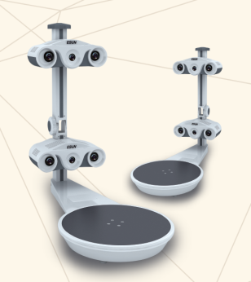
Shenzhen ESUN Display CO., LTD.
Continuous Support
ESUN Scanner Family
Full-Body Scanner
Self-Patented
CE /UL Certified
Head&Face Scanner
Desktop 3D Scanner
Relic Scanner
Customized Scanner
Fast Scanning Device From ESUN
Looking For Agents
Around the World
Desktop 3D Scanner
Mobile#: +86-135 1055 0224 Tel. No#: +86-755-3667-6600 -8041 Email: cheny@esdisplay.cn
Add: 1 floor, Building A Cultural and Creative Industry Park, Xinzhou South Road, Futian District, Shenzhen
Website: http://www.3dplus.cn

Slide 2
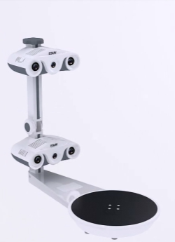
Shenzhen ESUN Display CO., LTD.
Benefits you are going to get from our Scanner!
Advanced Calibration System
Using both the 3D Calibration Mark and the Flat Calibration Mark
Reliable High Precision
High measurement rate with accuracy range from 0.05mm~0.1mm,
minimum point to point distance can be 0.7mm.
Two Capturing System guarantees the precision and the integrity.
Real Texture & Full Color Restoration
Seamless capture of high-quality geometry and texture & colors
Simultaneously, which guarantees the excellent post processing
output with the 500 M.P. cameras.
Automatic Scanning and Fixing Function
Self-Patented software can automatically finish the scanning and fixing
LED Light
Flexible Operation
Rotary Bed – steps can be managed according to the complexity of the
Target;
Free Touch-Up Selection through the live screen ;
Portable
Weight only 19KG
Non- contact Scanning
User-Friendly
Easy Post Processing ,no experience is required.

Slide 3
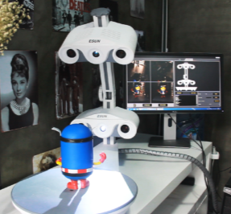
Shenzhen ESUN Display CO., LTD.
Spec.
Scanning Area | Φ250mmx240 mm(H)
Scanning Time | Approximate 3 minutes
Conformity | 98%
Post-Processing time | Depends
Accuracy | 0.05mm~0.1mm
Point Distance | 0.7mm
Scanning Manner | LED White Light(Non-Contact)
Texture | RGB 24 digit
Data Registration | Automatic
File Format | .wrl .obj .stl .ive.
Power | 220AC 198W
Computer configuration | I7/8G memory/Win7x64 operation sys
Size/ea. | 740mm(L)x380mm(W) x710mm(H)
Weight(5) | G/W 19.5KG N./W. 18.9KG

Slide 4
Shenzhen ESUN Display CO., LTD.
VS
 | ESUN’s Scanner | Maker BOT | Shining 3D | PHOTON
Price | USD 15,000 | USD 800 | USD 1,500 | USD 566
Portability | ● | ● | ● | ●
Camera | 4 | 1 | 2 | 1
Projector | 2 | ◌ | 1 | ◌
Light | LED White Light | Infrared Laser | LED White Light | Infrared Laser
Color | ● | ◌ | ◌ | ●
Resolution | 500 M.P. | 1.3M.P. | 1.3 M.P. | 1.3 M.P.
Scan Area | Ø250mmx240(H)mm | Ø203mmx203mm | Ø215mmx200mm | Ø180mmx250mm
Fixing | ● | ◌ | ◌ | ◌
Speed | 3 minutes | 12minutes | 3minutes | 5minutes
Accuracy | <0.05mm | 0.5 | 0.1 | 0.25
File format | WRL,STL,OBJ,IVE… | STL | STL,ASC | STL, XYZ,PLY,PTX
Evaluation | Commercial use | Low End Use | Regular Use | Low End Use
All Rights Reserved to ESUN in 2014 made by Gary Li

Slide 5
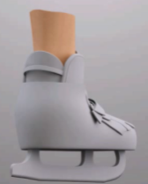
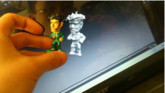
Shenzhen ESUN Display CO., LTD.
Application ESUN’s scanning system can be widely used
SHOES
Customization
TOY Duplication
EDUCATION Extension
DESIGN Assistance

Slide 6
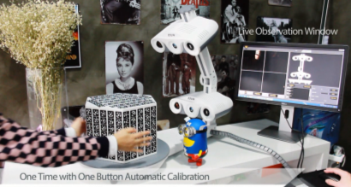
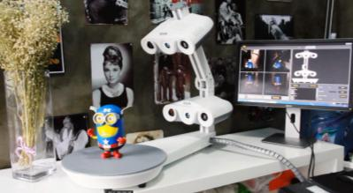
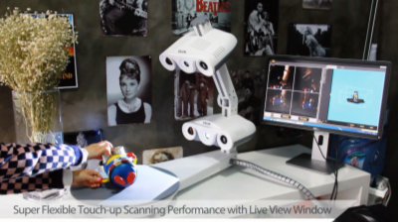
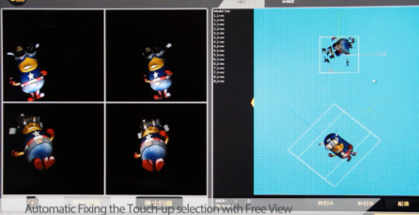
One Button Full Automatic Calibration
One Button Full Automatic Scanning in Color
Flexible Touch-Up Scanning With Live Window
Automatic Fixing the Touch-Up selection area with Free View

Slide 7
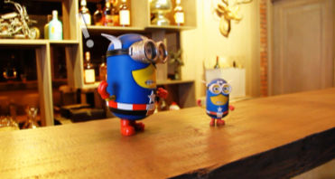
Minutes Job

Slide 8
Shenzhen ESUN Display CO., LTD.
Come and Embrace the 3D Future
…ON THE WAY…
END IN SOMEWHERE
YOU DESIRE FOR
3D Scanner & 3D Printer
BEGIN IN 2004
MODELING&ENGINEERING
ESUN(INDUSTRY)
PROFESSIONAL 3D SOLUTION SUPPLIER
THANKS!
PLS FEEL FREE TO CONTACT BY cheny@esdisplay.cn

